Slide 1
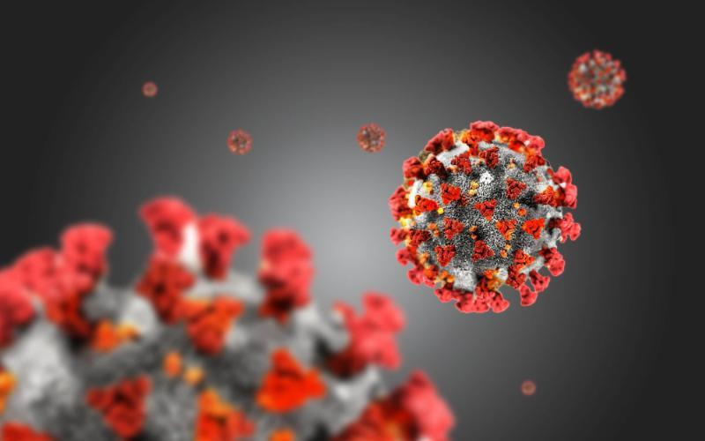
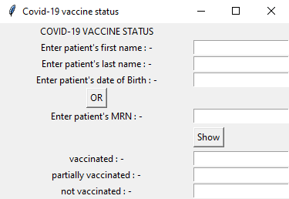
Covid-19 Vaccine Status GUI for Healthcare Facilities
Connect Immunization record database with GUI to check patient’s Covid-19 Vaccine status.
Link: https://github.com/ksu-hmi/GUI-for-Covid-19-Vaccine-Status
Daya Kansagra and Pooja Mistry

